Slide 1
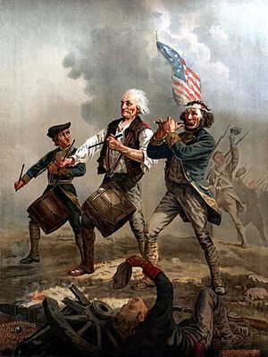
Revolution!
An Arts Integrated Learning Unit Following the Brain Targeted Teaching Model
5th Grade Social Studies
Anna Carello
Johns Hopkins University

Slide 2
Presentation Contents
Contents
Slide Number
Statement of unit purpose and student learning objectives
Unit overview and 10 day schedule
Explanation of specific brain targeted teaching components and their influence on student learning throughout the unit
References
3
4
5-11
12-13

Slide 3
Purpose & Learning Objectives
Purpose:
To have students evaluate the events leading up to the American Revolution by writing skits and then performing them in front of the campus television studio’s green screen.
This unit is based on the Brain Targeted Teaching Model (Hardiman, 2003) and integrates the arts by using enactment and repeated rehearsals to improve recall of material (Rinne et al, 2011).
By the end of this unit, students will be able to:
Identify the major causes and events leading to the American Revolution
Evaluate the significance of each event and its effects
Understand the emotional climate in the colonies leading to the Revolution
Effectively and safely use the school’s television studio equipment and computer green screen technology

Slide 4
Unit Overview and Schedule
Day 1
Review previous chapter’s material
Introduce and discuss unit project
Day 2
Day 3
Day 4
Day 5
Group share of brainstorming done individually as homework
10 minute class mini-lesson and discussion (based on homework, Cause/Event #1)
Script writing/Teacher check-in
10 minute class mini-lesson and discussion (based on homework, Cause/Event #2)
Script writing/Teacher check-in
Tour of campus television studio
Create “big picture” concept map of events leading to Revolution as a class
Distribute project rubric
Select heterogeneous groups (student’s choose)
After share, each group will select one event leading to the American Revolution to perform as a skit
Script writing
Assign homework: Cause/Event #1
Assign homework: Cause/Event #2
Assign homework: Cause/Event #3
Day 6
10 minute class mini-lesson and discussion (based on homework, Cause/Event #3)
Day 7
Celebration!
Day 8
Day 9
Day 10
10 minute class mini-lesson and discussion (based on homework, Cause/Event #4)
10 minute class mini-lesson and discussion--- Review of events and discussion of connections to current events
Performances & Filming
Performances & Filming
Self-Assessment and Reflection
Rehearsals/Teacher check-in
Assign homework: Use the internet to find a picture for group’s green screen background
Assign homework: Cause/Event #4
Students will view the filmed skits and see the computer generated images in each skit for the first time
Rehearsals/Teacher check-in

Slide 5
Brain Target 1: Setting the Emotional Climate for Learning
Creating a positive emotional climate conducive to effective learning will be established by:
Reviewing classroom values and expectations of behavior when in the television studio
Sharing the schedule and project rubric with students early in the unit in order to establish an element of predictability (day 2)
Allowing students to choose their skit groups
Allowing groups to choose a cause/event leading to the Revolution to theatrically enact with costumes and props
Circulation of the teacher to each group during their brainstorming and rehearsal stages for facilitation, encouragement, and praise
Planning a class celebration at the end of the unit when students will see the entire class’s computer enhanced skits

Slide 6
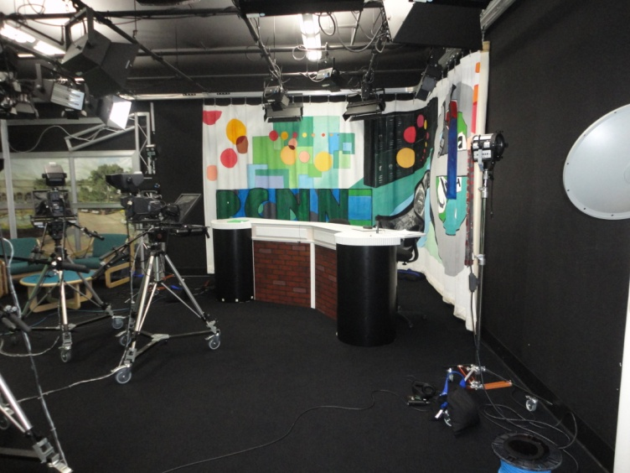
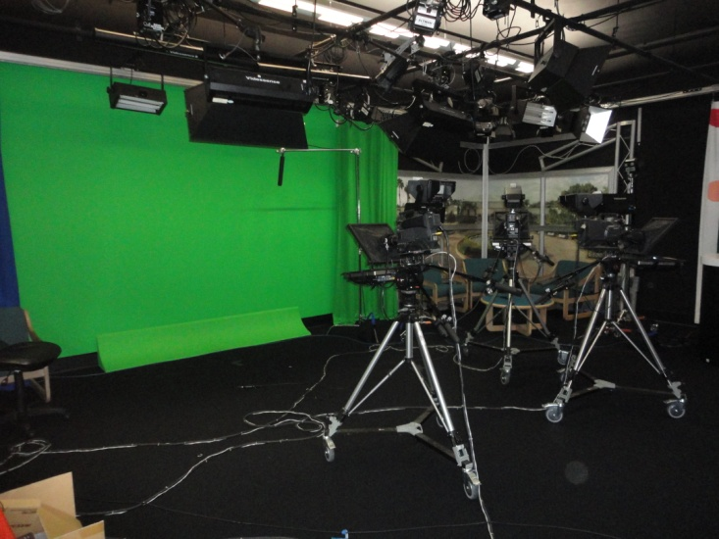
Brain Target 2: Creating the Physical Learning Environment
The physical learning environment during this unit will be enhanced by:
Student created bulletin boards around the classroom
Playing of Revolution era background music as students rehearse their skits (e.g. “Yankee Doodle”)
Moving classroom furniture around to accommodate rehearsal space
Clearly displaying the project rubric and schedule so that all students may reference it during their rehearsal time
Maintaining traditional classroom rituals and behavioral expectations
Using the school’s television studio equipped with green screen technology to incorporate novelty and inspire creativity

Slide 7
Brain Target 3: Designing the Learning Experience
The students’ learning experience will be guided by:
The teacher referencing the school’s social studies curriculum standards before and during the unit
A clear explanation of the learning goals of the unit during Day 1 discussion
Utilization of concept maps during whole group and small group work on each cause/event of the Revolution
Beginning days 4-8 with a “mini-lesson” on each cause/event to review significance (this “mini-lesson” time can also incorporate a word-study supporting balanced literacy model of the school)
French and Indian War!
Taxes!
Massacre, Boycotts, and Tea Party!
Revolution!
Midnight Ride and Minutemen!

Slide 8
Brain Target 4: Teaching for Declarative and Procedural Knowledge
Students should master the following objectives:
Objective 1: Identify the major causes and events leading to the American Revolution
Activities: Students will create and discuss concept maps for each event first in small groups and then as a whole class. Students will also have a choice in what cause or event they would like to enact in a creative skit.
Objective 2: Evaluate the significance of each event and its effects
Activities: Students will consolidate their thinking of each event from the “Big Picture” during each 10 minute “mini-lesson” on days 4-8. Students will also participate in classroom discussion on current events with the same theme in order to create an emotional connection to the content.

Slide 9
Brain Target 4 (cont’d): Teaching for Declarative and Procedural Knowledge
Objective 3: Understand the emotional climate in the colonies leading to the Revolution
Activities: Students will write a script that demonstrates their understanding of the mood of the event based on dialogue and character actions. Teacher will also integrate music from the era while students are rehearsing skits to help stimulate emotional arousal or encourage an emotional connection to the time period.
Objective 4: Effectively and safely use the school’s television studio equipment and computer green screen technology
Activities: Students will tour the television studio before rehearsals begin, review safety protocols, as well as maintain classroom rituals and behavior in the new space.

Slide 10
Brain Target 5: Teaching for Extension and Application of Knowledge
The students will apply their knowledge of each event leading to the American Revolution by the following activities:
Analyzing different perspectives and historical facts in their nightly homework assignments
Engaging in inductive thinking that is evident in their skits through dialogue, setting, and actions of characters
Promoting creative thinking in their small groups with repeated rehearsals and active participation
Elaborating on ideas by discussing in small groups

Slide 11
Brain Target 6: Evaluating Learning
Students will be evaluated in the following ways:
On a daily basis while the teacher circulates to each group, but also specifically during the “Teacher check-in” on days 4-7. The teacher will provide immediate feedback to each group’s skit, check for historical accuracy, and guide their learning experience in a positive direction during these check-in times.
By measuring student performance on homework assignments thoughtfully designed to encourage analysis and deeper understanding of concept material.
As a group based on the rubric distributed, discussed, and referred to throughout the unit.
As an individual through both written and oral self-reflection. The written self-reflection will be submitted to the teacher and followed up by a conference with the teacher or teaching assistant.

Slide 12
References
Hardiman, Mariale M. (2003). Connecting brain research with effective teaching. Lanham, Maryland: Rowman & Littlefield Publishers.
Rinne, L., Gregory, E., Yarmolinksaya J., & Hardiman M., (2011) Why arts integration improves long term retention of content. Mind, Brain and Education, 5(2), 89-96

Slide 13
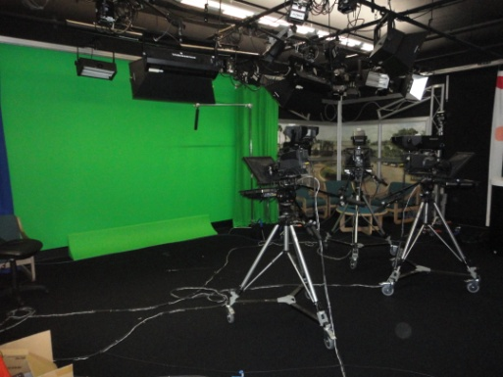
Picture References
Via TLMedia.com
Via BRPVideo.com
The Spirit of ‘76 by Archibald MacNeal Willard
Via Wikipedia
Pine Crest School Television Studio
Pictures taken by Anna Carello

